Slide 2
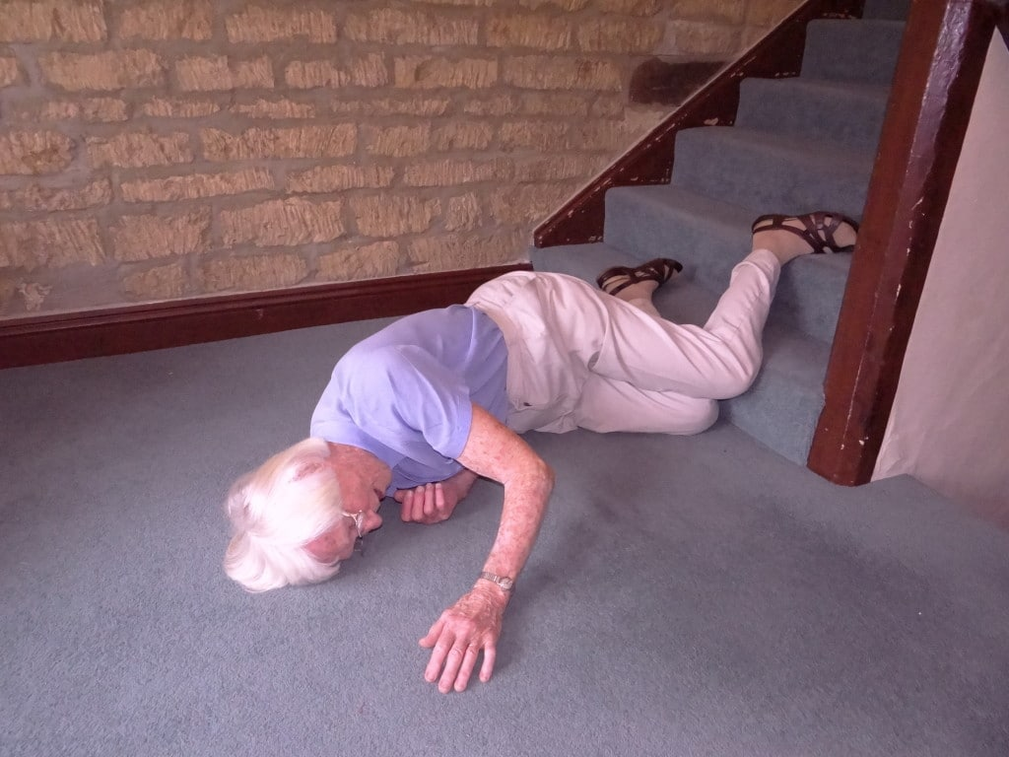
FALL IN ELDERLY
Have you fallen in the past year ?
Are you afraid of falling?
Do you have trouble climbing stairs?
Do you have trouble getting up from the chair?

Slide 3
Things you need to get checked to prevent falls
Balance problems
Medicine history
Parkinsons disease
Muscle strength
Heart conditions
ECG
Drop in blood pressure while standing
Vitamin B12 levels
Vertigo

Slide 4
What are the impacts of fall?
Fear
Loss of confidence
Painful injuries
Fractures
Brain hemorrhage and injury

Slide 5
A thorough check up and screening is required to prevent falls in elderly. Do not wait for the first fall to occur ! SO WHAT ARE YOU WAITING FOR? GET YOURSELF EXAMINED !

Slide 6
POLYPHARMACY
It is prescription of multiple medicines.
With increasing age, many health problems arise and multiple medicines are prescribed at different instances.
This can lead to consuming unnecessary medicines and you can be at the receiving end of various side effects.

Slide 7
ANSWER THE BELOW QUESTIONS TO SEE IFYOU ARE THE RECEIVING END OF POLYPHARMACY
Do you take more than 5 medicines daily?
Do you understand the reason for each of your medicines?

Slide 8
WHAT CAN BE DONE ABOUT THIS?
It is important to consult a physician in order to review the medicines and make sure that only required medicines are consumed.
Never continue medicines on your own for temporary relief of complaints.

Slide 9
DEMENTIA/MEMORY LOSS
Normal ageing can cause the following
Slowed thinking
Slowed reaction time
Mild recent memory loss

Slide 10
ARE YOU SCARED OF GETTING ALZHEIMERS?
Not very common in people who are literate ( good IQ)
Normal ageing causes memory loss, it is not alzheimers

Slide 11
SELF ASSESSMENT FOR RISK OF ALZHEIMERS
Mini-Cog test
3 item recall test
Drawing a clock
If you feel your memory loss is more than expected for your age, its time to visit your physician !
Early detection can be helpful
Also alzheimers can be prevented by staying mentally active, exercise, yoga, playing cards or board games and a healthy diet !

Slide 12
Most important correctable cause for memory loss
vitamin B12 deficiency
It is very important to check B12 levels regularly and take appropriate medicines.
Nearly all people have vitamin b12 deficiency, and it affects the brain functioning at various levels

Slide 13
FEW IMPORTANT SIGNS OF VITAMIN B12 DEFICIENCY
Pale skin and reduced hemoglobin
Memory loss
Tingling sensation in hand and feet
Severe fatigue and weakness
Loss of balance
Fainting sensation

Slide 14
WEIGHT LOSS
WHAT IS SIGNIFICANT WEIGHT LOSS?
Weight loss of more than 5 kg in 6 months
WHAT NEEDS TO BE DONE ?
Patient requires thorough evaluation for nutritional deficiencies and other diseases

Slide 15
Urine and stool incontinence
Do you have trouble controlling urine?
Decreased urine?
Dribbling of urine?
Urine urgency?
Increased frequency?
Increased urination at night?

Slide 16
WHAT CAN BE DONE ABOUT IT?
IT IS IMPORTANT TO LOOK FOR REVERSIBLE CAUSES
Urine infection
Diabetes
Heart failure
BPH
Side effects of medicines

Slide 17
SUFFERING FROM INSOMNIA
Do you feel sleepy during the day?
Do you have difficulty falling asleep at night?
Chronic pain?
Acid reflux ?
Loud snoring?
Urge to move legs with uncomfortable sensations?

Slide 18
SLEEP HYGIENE
Avoid caffeine, alchohol after lunch
Limit liquids in evening
Keep regular bedtime- waketime schedule
1 nap/ day
Only go to bed when tired and sleepy
If unable to sleep after 20 min, get out of bed and do something relaxing

Slide 19
BLOOD PRESSURE MONITORING
Patients with diabetes, heart illness, paralysis, target BP is <150
Lesser BP can be dangerous
So please do not worry about the BP levels and get it confirmed from your doctor if it is okay !

Slide 20
DIABETES
MODERATE control should be targeted
> 65 years, hba1c of 7.5 is good
Strict control can be dangerous
Screening of eyes, kidney
Screening of vitamin D and B12 levels

Slide 21
TREMOR
Visit doctor to
Screen for Parkinson disease
Check thyroid function
Liver function
Kidney disease
Any medicines causing it

Slide 22
OSTEOPOROSIS
Screening important
Simple tests like vitamin d and calcium

Slide 23
CANCER SCREENING
Colon ca , 50-75 years, annually screening
Breast cancer, 50-75 years, every 1-2 yearly
Cervical cancer, 21-65 years, every 3 hourly
Prostate cancer, >50 years, 1-2 yearly

Slide 24
SCREENING FOR OTHER DISEASES
Carotid disease ( risk of paralysis) - > 60 years, heart disease, raised cholesterol, smoker- screen once a year
Abdominal aortic aneurysm- > 60 years- smokers, once a year
Diabetes- >45years , once a year

Slide 25
ADULT VACCINATIONS
FLU VACCINE – every yearly
Pneumococcal vaccine ( prevents pneumonia )- > 65 years- 1 dose followed by 2nd dose after 6-12 months
DPT- 18-64 years, booster dose every 10 years
Typhoid – 1 dose and then booster dose every 3 yearly

Slide 26
WARNING SIGNS OF HEART ATTACK
Chest pain, sweating, left hand pain, vomiting, loose motions, acidity like pain, fainting
WHAT TO DO?
Visit nearest clinic for ECG
DO NOT IGNORE ACIDITY SYMPTOMS . IT IS ALWAYS ADVISABLE TO GET A ECG DONE

Slide 27
STROKE /PARALYSIS
Fainting, severe headache, vomiting, weakness in hands or legs, slurred speech, assymetrical face
WHAT TO DO?
CONSULT DOCTOR IMMEDIATELY

